Slide 1

Replication and Improvement of ‘The Impact of Campaign Finance Laws on Party Competition’ (2013)
By Ruairí Hallissey

Slide 2
Background
By Joshua Potter and Margit Tavis (2013)
Paper looks at whether campaign finance laws effect the number of political parties (ENP)
Theory: Expensive campaigns are constraints on party political actors
Hypothesis: Countries with laws that promote fund parity will have a greater number of effective political parties

Slide 3
Methodology
OLS Regression
Data for 130 countries
Post Election Effective Number of Parities (y)
No. Parties W
Weighted by relative strength
Fund Parity (x1)
Donation Limits
Spending Limits
Free Media Access
Direct public funding
Controls
Years as Democracy, Federal vs. Non-Federal, Parliamentary vs. Presidential, District Magnitude, Ethnic Fractionalization

Slide 4
Dependent variable: ENP
-------------------------------------------
Full Post 1974
---------------------------------------------------------------
fundparity4 0.438*** 0.454**
(0.153) (0.210)
demyears 0.013 -0.013
(0.011) (0.033)
Federal -0.213 -0.228
(0.476) (0.754)
Presidential -0.172 -0.025
(0.211) (0.284)
log(avemag) 0.601** 0.343
(0.301) (0.446)
Fract .956 -0.427
(1.290) (1.911)
log(avemag):fract -0.750 -0.576
(0.641) (0.889)
Constant 3.070*** 4.383***
(0.764) (1.217)
---------------------------------------------------------------
Observations 90 54
R2 0.198 0.168
Adjusted R2 0.129 0.041
Residual Std. Error 1.647 (df = 82) 1.792 (df = 46)
F Statistic 2.885*** (df = 7; 82) 1.327 (df = 7; 46)

Slide 5
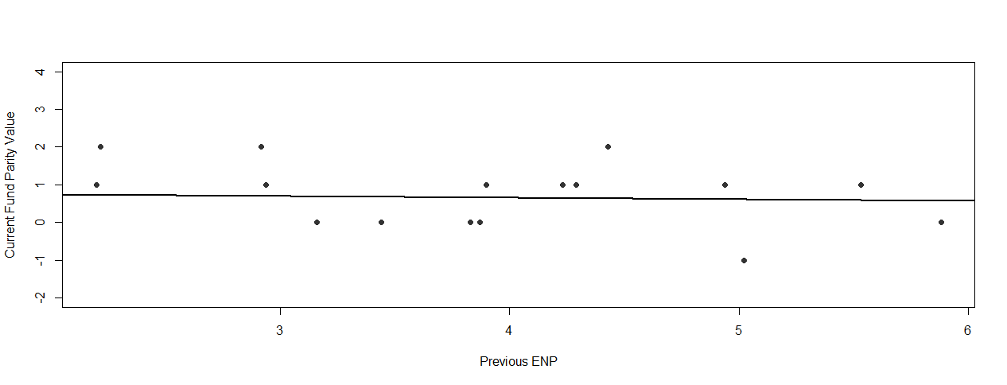
Reverse Causality?
Fig. 1. Plot of ‘current’ level of fund parity against ‘previous’ effective number of parties
Note: ordinary least squares regression line included to demonstrate that there is no relationship between the two variables (r 0.04).

Slide 6
Dependent variable: ENP
--------------------------------------------------
Full Full w/Recode
-----------------------------------------------------------------------
fundparity4 0.438*** 0.437***
(0.153) (0.157)
demyears 0.013 0.013
(0.011) (0.011)
Federal 0.213 -0.295
(0.476) (0.480)
Presidential -0.172
(0.211)
Pres_cat -0.346
(0.422)
log(avemag) 0.601** 0.439
(0.301) (0.319)
fract 0.956 0.522
(1.290) (1.309)
log(avemag):fract -0.750 -0.190
(0.641) (0.727)
Constant 3.070*** 3.195***
(0.764) (0.770)
----------------------------------------------------------------------------
Observations 90 85
R2 0.198 0.214
Adjusted R2 0.129 0.143
Residual Std. Error 1.647 (df = 82) 1.645 (df = 77)
F Statistic 2.885*** (df = 7; 82) 2.996*** (df = 7; 77)
===============================================
Note: *p<0.1; **p<0.05; ***p<0.01

Slide 7
Dependent variable: ENP
-------------------------------------------
Full w/Recode Interactive
-----------------------------------------------------------------
fundparity4 0.437*** 0.444***
(0.157) (0.153)
demyears 0.013 0.025**
(0.011) (0.012)
Federal -0.295 -0.270
(0.480) (0.467)
pres_cat -0.346 1.095
(0.422) (0.744)
log(avemag) 0.439 0.434
(0.319) (0.310)
fract 0.522 0.223
(1.309) (1.280)
demyears:pres_cat -0.055**
(0.024)
log(avemag):fract -0.190 -0.167
(0.727) (0.707)
Constant 3.195*** 2.790***
(0.770) (0.769)
------------------------------------------------------------------------------
Observations 85 85
R2 0.214 0.266
Adjusted R2 0.143 0.189
Residual Std. Error 1.645 (df = 77) 1.600 (df = 76)
F Statistic 2.996*** (df = 7; 77) 3.446*** (df = 8; 76)
==============================================
Note: *p<0.1; **p<0.05; ***p<0.01

Slide 8
Analysis of Variance
=================================
Statistic N Mean St. Dev. Min Max
---------------------------------------------------------
Res.Df 2 76.50 0.707 76 77
RSS 2 201.48 9.780 194.566 208.397
Df 1 1.000 1 1
Sum of
Sq 1 13.831 13.831 13.831
F 1 5.403 5.403 5.403
Pr(> F) 1 0.023 0.023 0.023
------------------------------------------------------------

Slide 9
Dependent variable: ENP
-------------------------------------
Post 74 Additive Post 74 Interactive
-----------------------------------------------------------
fundparity4 0.472** 0.479**
(0.224) (0.223)
demyears -0.016 0.015
(0.035) (0.044)
fed -0.340 -0.515
(0.775) (0.789)
pres_cat -0.027 1.289
(0.578) (1.323)
log(avemag) 0.139 0.149
(0.487) (0.486)
fract -1.108 -1.364
(1.994) (2.002)
demyears:pres_cat -0.074
(0.067)
log(avemag):fract 0.102 0.100
(1.061) (1.058)
Constant 4.612*** 4.111***
(1.248) (1.325)
-----------------------------------------------------------
Observations 49 49
R2 0.177 0.202
Adjusted R2 0.037 0.042
Residual Std. Error 1.819 (df = 41) 1.814 (df = 40)
F Statistic 1.261 (df = 7; 41) 1.262 (df = 8; 40)
============================================
Note: *p<0.1; **p<0.05; ***p<0.0

Slide 10
Analysis of Variance
===================================
Statistic N Mean St. Dev. Min Max
------------------------------------------------------------
Res.Df 2 40.50 0.707 40 41
RSS 2 13.68 2.844 131.673 135.696
Df 1 1.000 1 1
Sum of
Sq 1 4.023 4.023 4.023
F 1 1.222 1.222 1.222
Pr(> F) 1 0.276 0.276 0.276
-------------------------------------------------------------

Slide 11
Fin

